Slide 1
Internet Usage as a Predictor for Political Violence in Western Nations
Ethan Witkowski

Slide 2
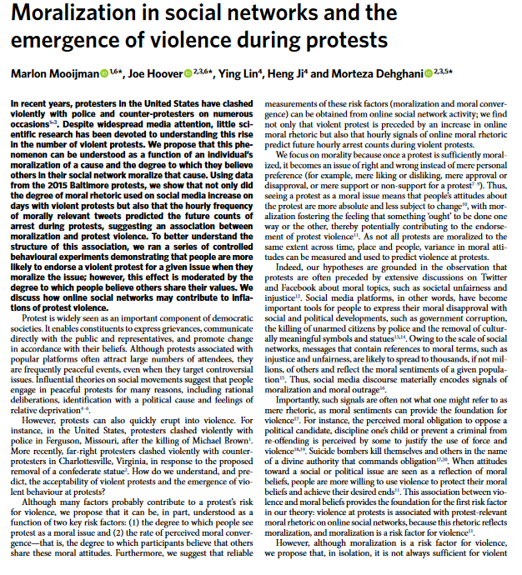
Hypothesis
In western nations, greater internet usage predicts greater socio-political violence
Notes:
Hypothesis: At the national level (westernized nations), greater internet usage predicts greater political violence

Slide 3
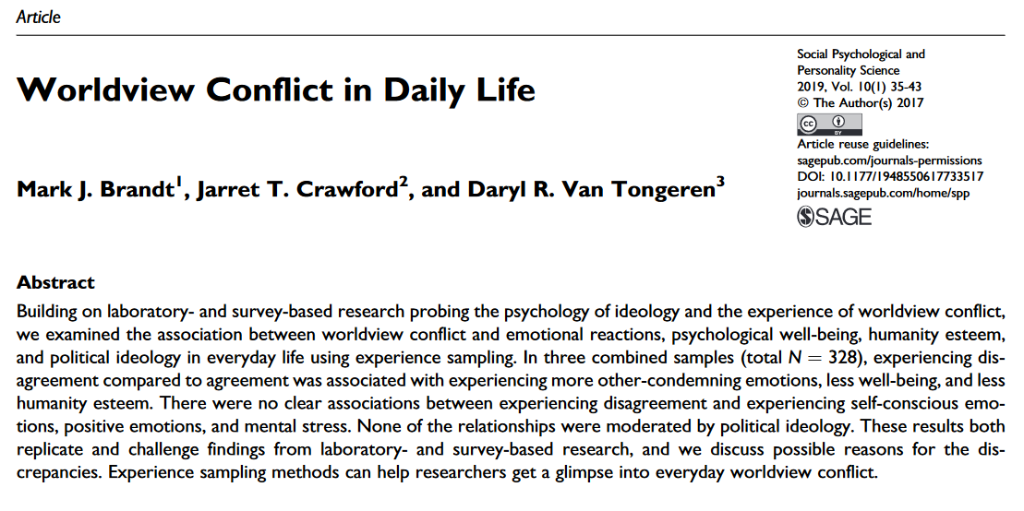
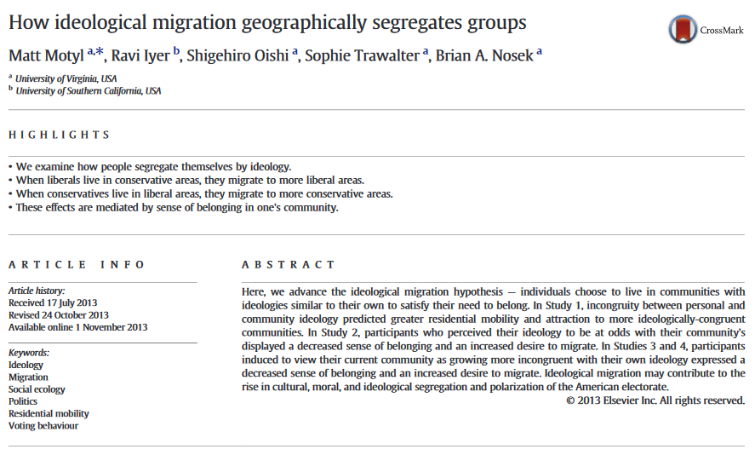
Causal Mechanisms
Worldview Conflict Hypothesis
Brandt, Crawford, Van Tongeren (2019)
Greater exposure to conflicting political worldviews from internet usage
Ideological Migration Hypothesis
Motyl et al. (2013)
Motivated avoidance of counter-attitudinal information
Selective exposure to information
Notes:
Worldview Conflict is hypothesized to increase affective polarization
Greater salience of conflicting worldviews from internet usage results in greater negative emotion associated with outgroups
Ideological Migration is hypothesized to increase political polarization
Individuals will choose to interact in communities with similar ideologies as their own
Leads to echo chamber effect

Slide 4
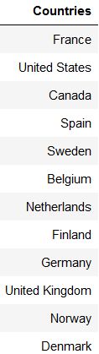
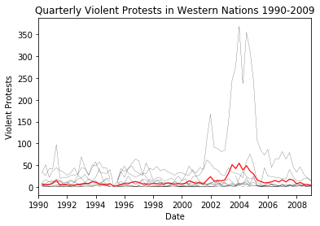
Sampling
Notes:
-Subset of developed, westernized nations from 1990-2009

Slide 5
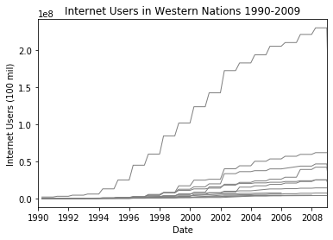
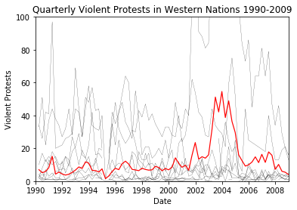
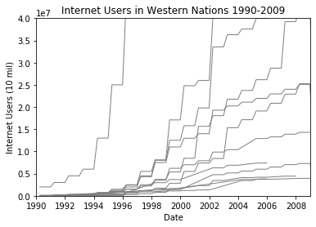
Time Series
Total Trend
Zoom Trend
Notes:
-Appears to be sufficient variation in independent, dependent variables for regression analysis

Slide 6
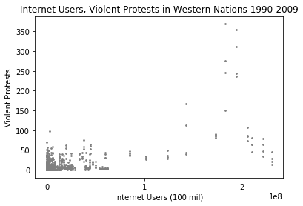
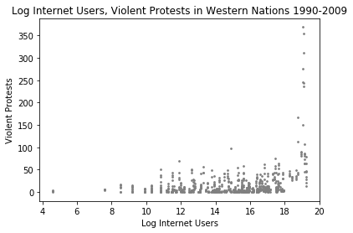
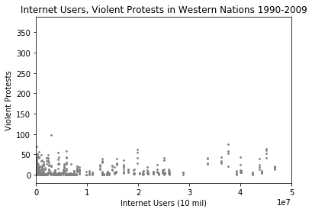
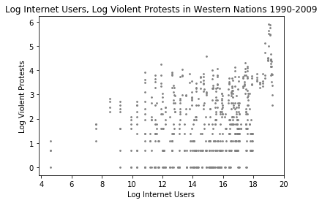
Exploratory Analysis
Notes:
-Appears to be exponential relationship between

Slide 7
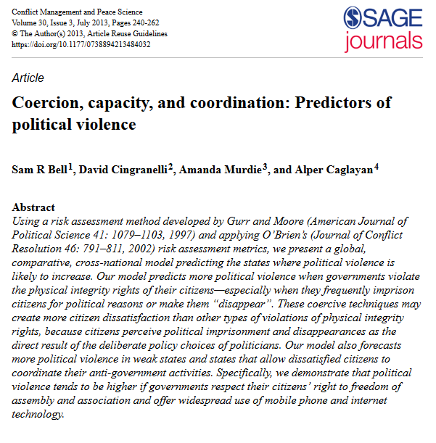
Methodology
Cross-national study predicting level of political violence
Problem:
Find which characteristics are predictors of a country’s level of socio-political violence
Solution:
Least squares regression panel model

Slide 8
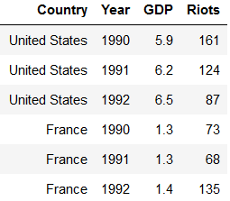
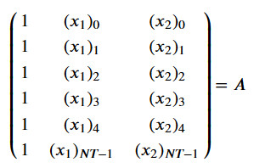

Panel Data
Each observation represents a country at a certain time

Slide 9


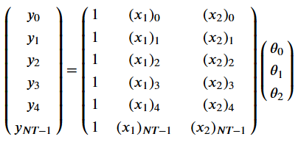




Least Squares Regression Model
1. Data-Fitting
Outcome Variable:
Quarterly national violent protests
Regressors:
Country characteristics predicting socio-political violence
2. Parameter Estimation

Slide 10
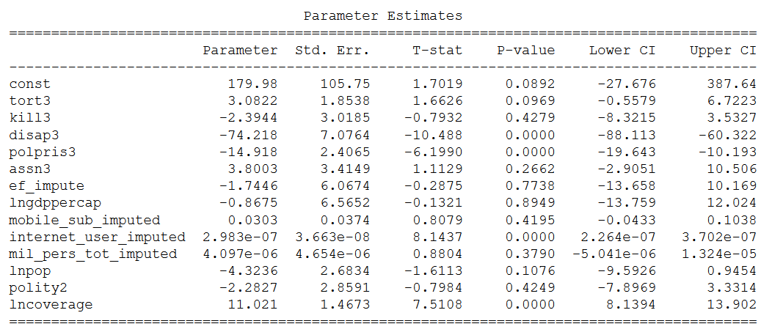

Regression Output
represents the change in outcome variable given a one-unit change in regressor
Interpretation:
An additional 1 million internet users predicts a 2.98 increase in number of quarterly violent protests (p = .0000)

Slide 11
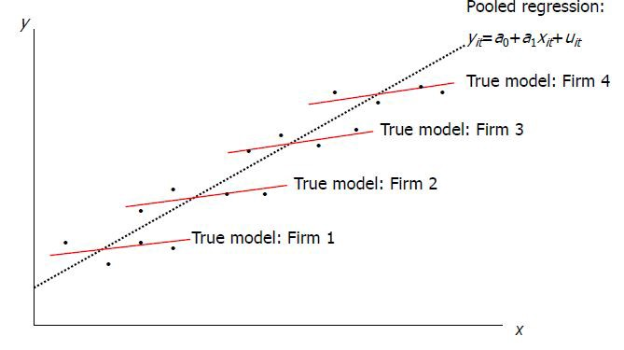
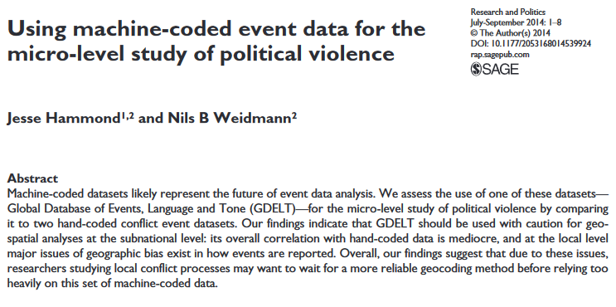
Discussion
Limitations
Lack of Causality
Pooled OLS design
Lack of protest severity measure
Early-stage social internet technology from 1990-2009
Less video/photographic stimuli
Machine event-coding inaccuracies
Hammond, Weidmann (2014)
Notes:
-Pooled OLS neglects ‘in-between’ differences in countries – more models should be fit (fixed effects, random effects)
-Social media platforms were not as widespread in 1990-2009 as they are now – this analysis should be re-done with more recent data
-Research has shown that machine-event coding has inaccuracies and is not 100% reliable – this most probably affected the violent protest measures in this analysis
-

Slide 12
Further Research
More directed study is necessary
Moijmann, Hoover, Lin (2018)
Event-specific analysis of internet use and violent actions
Notes:
-Study finds that moralized tweets correlated with violent actions in 2015 Baltimore protests

